Slide 1

Opportunities & Challenges in Retail
Brian Diffenderfer
July 6, 2015

Slide 2

Director of Meat & Seafood
Brian Diffenderfer
I’m a 32 year veteran of the grocery industry . I spent 24 yrs with The Great A&P Tea Co. working with the Meat & Seafood Merchandising and Category Management teams.
A&P Tea Company
  Meat & Seafood Manager
  Meat Buyer
  Procurement Manager
  Meat & Seafood Regional Merchandiser
Daymon Worldwide
  Supervalu & Ahold USA Business Development Manager
Ahold USA
  Category Merchandiser Fresh Meat

Slide 3





Daymon Worldwide
Key Services Summary
Private Brand Strategy
Private Brand Program Management
Category Analytics and Insights
Product Sourcing
Supplier Management
WIC Services (USA)
Brand and Product Development
Brand and Packaging Design
Consumer-Centric Solutions Development and Implementation
Shopper Marketing
Digital and Social Media
Global Import Solutions
Global Export Solutions
Global Distribution
Logistics Management
Supplier Sourcing
Quality Assurance
Retail Solutions / Innovation
Total Store Remodeling
New Store Setups
Large Scale Category Implementations
Category Updates
Audits and Product Recalls
Display and Fixtures Assembly
Store Mapping
In-Store Product Sampling
Taste Tests
Grand Openings
In-Store Event Staffing
Guerilla Marketing
Sampling Programs
Mobile Tours
Events Staffing
Mystery Shopping
Notes:
This is a summary of key services from our individual business units.
Private Brand Development: Brand Strategy, Category analytics, product sourcing
Galileo: Brand & packaging design & marketing
Omni: Global Importing & Exporting, Global distribution, Logistics, Supplier sourcing & quality assurance
SAS: Store Resets, New store set-ups, audits & Product recalls, Store mapping (POG)
Interactions: Demo’s, Taste test, Grand Openings, Guerilla Marketing, Mystery Shoppers

Slide 4
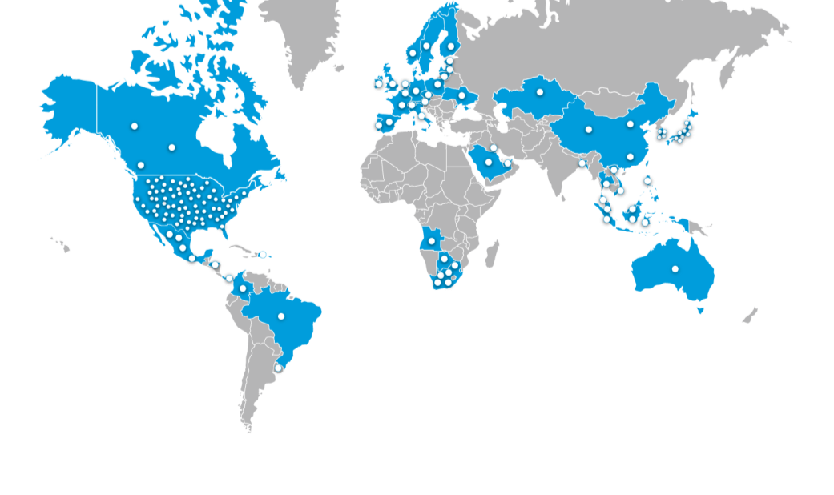


Daymon Worldwide
100⁺
39,000
51
14
6,000
Notes:
We are working in 51 Countries
We work with a 100+ retailers
We are in 14 channels of trade
We have 39,000 associates
and
We work with 6,000 Manufactures

Slide 5


















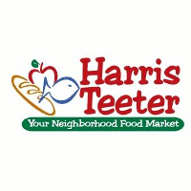




















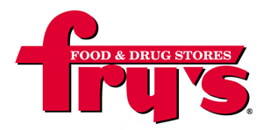














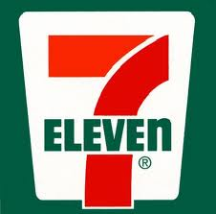













U.S. Retail Partners
Grocery
Drug
Mass/Club
Value
Convenience
Auto
Notes:
Grocery: Kroger, Wegman’s, Ahold, Giant Eagle and in Canada Overwaitea
Drug: Rite Aid and CVS
Convenience: 7/11
Mass/Club: Super Target, Costco, Sears and Kmart
Value; Dollar General
Auto; Advance Auto Parts

Slide 6
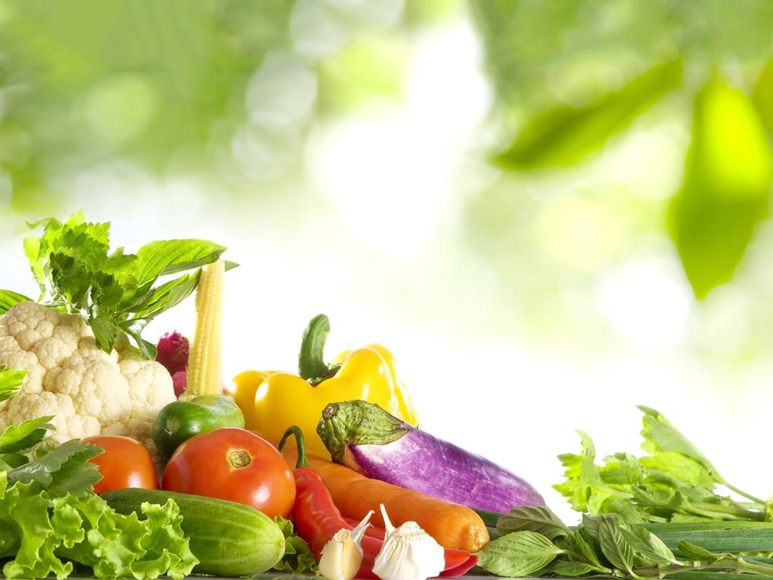
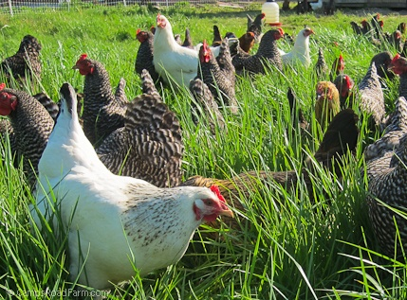
Opportunities & Challenges
These days, everyone wants to be Fresh…
Specialty Stores
Convenience
Drug Stores
Mass/Club
Dollar Stores

Slide 7
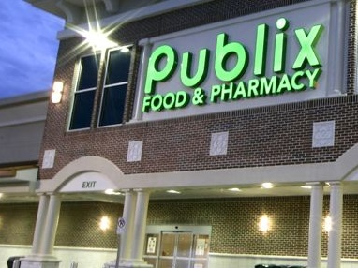
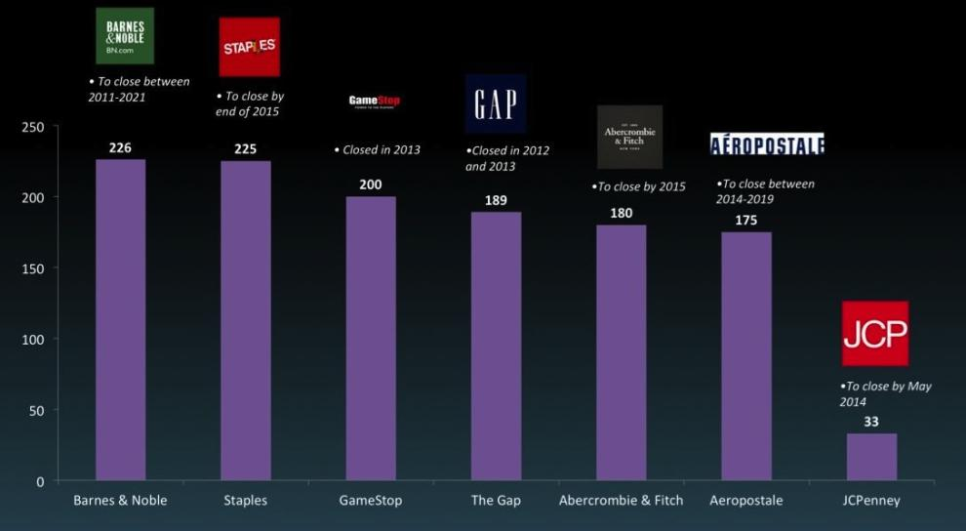
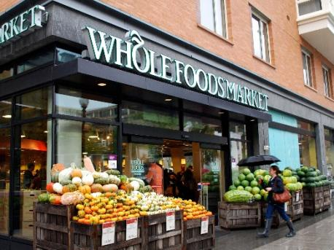
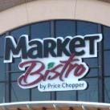
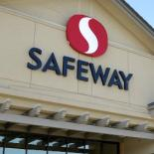
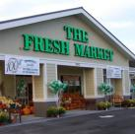





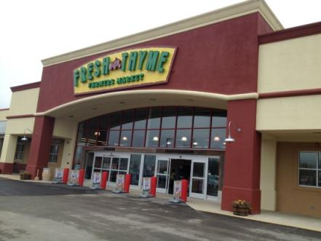
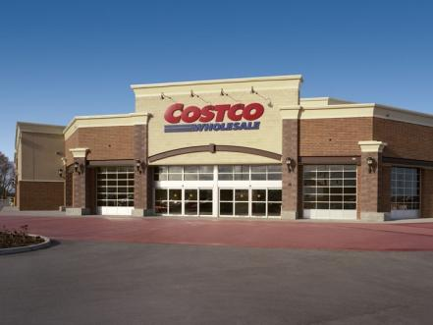
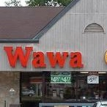


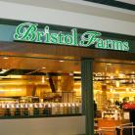


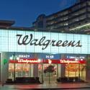



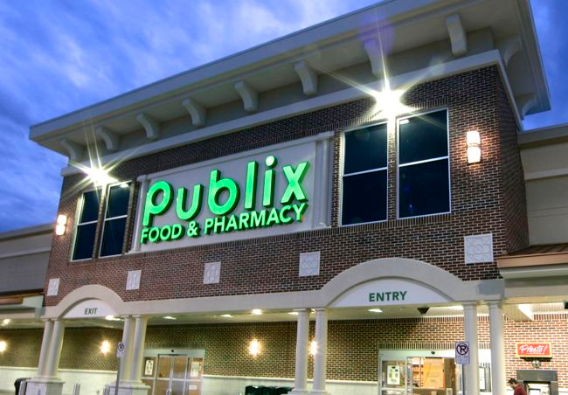
Fresh…Across Retail
Traditional
grocery retailers upping their fresh proposition
Specialty
retailers
setting the
bar on expectations
for Fresh
Tremendous growth of
small format
fresh markets
Non-Grocery venturing
into Fresh
Notes:
Specialty Retailers ; Whole Foods, Wegmans and Mariano’s
Traditional grocery retailers upping their game in Fresh; Publix, Safeway, Market Bristro (Price Chopper)
Non Grocery retailers venturing into fresh: Wawa, Amazon, Walgreens, Sheetz
Tremendous growth of small format fresh markets: PCC, Fresh Thyme and Mrs. Greens

Slide 8
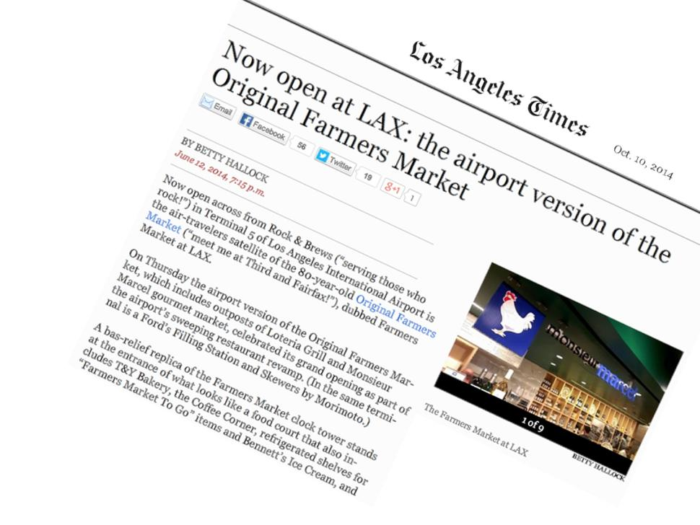
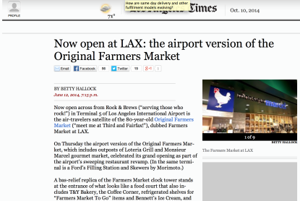
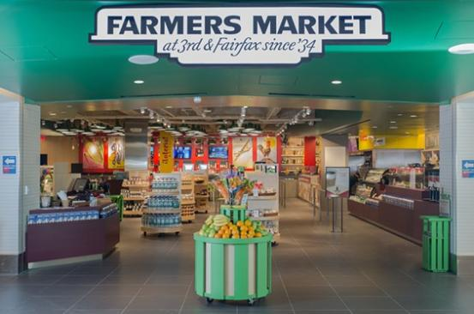

Even
Airports
Are Getting
Fresh…
Notes:
http://touch.latimes.com/#section/-1/article/p2p-80487671/
A microcosm of the famous "original" market at Fairfax and Third, this satellite space looks just like it, right down to the inclusion of some of the famous Farmers Market green wooden carts and shopping bags - it even has a mini 3-D-esque version of the white clock tower on the wall outside (ripe for photo ops).
Inside, the prime spot has gone to Jimmy Shaw's Lotería Grill - a resident at the Original Farmers Market since 2002 - whose colorful red décor, loteria card posters and yellow stools definitely beckon you toward the bar at the rear. They debuted new loteria cards - El Farmers Market and El LAX - on the opening-day menu, but either way you can pre-flight by sipping a margarita and watching your burrito or tostada come to life in the glass-fronted kitchen.

Slide 9
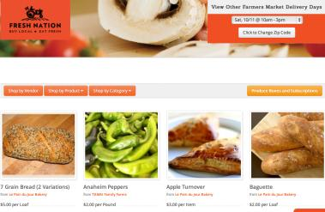
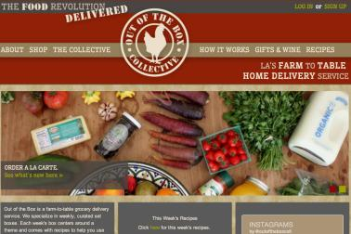
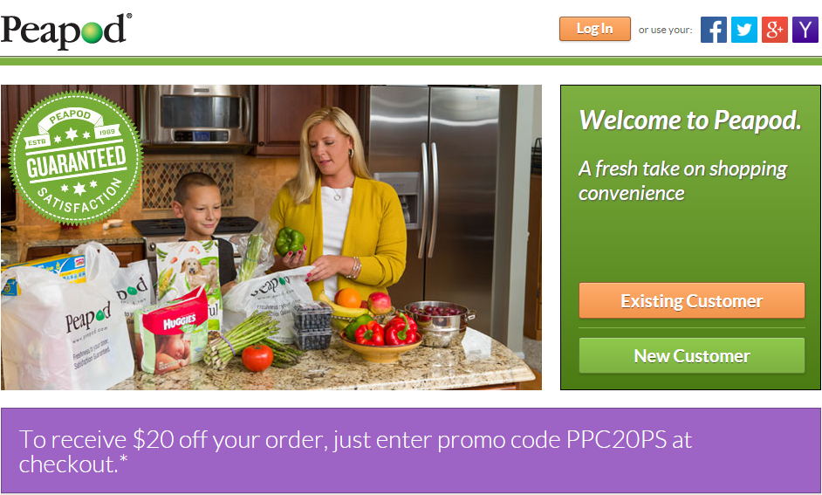
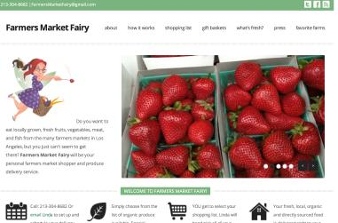
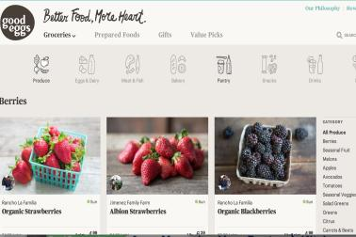
Fresh To Your Door…
Notes:
Fresh to your Door: Fresh Nation, Out of the Box Collection, Farmers Market Fairy, Good Eggs, Peapod & Fresh Direct

Slide 10

Opportunities & Challenges
Protein costs & retails are going up and the volume is dropping…
Avian Flu
PED virus
Beef Shortage
Feed Prices
Bad Weather

Slide 11
Product Cost
PRICE INCREASES DRIVING SHOPPERS AWAY
FROM THE MEAT CASE
Volume
ARP
4% decline in the number of Fresh Meat trips
+16.2%
-6.0%
Beef
+13.5%
6% less Fresh Meat volume purchased each trip
-5.7%
Pork
+3.4%
+2.6%
0.5% average decline in households purchasing Beef, Pork and Chicken
Chicken
+2.6%
+13.2%
Ground Turkey
Notes:
Price increases are driving shoppers away from The meat case

Slide 12
Promotions/Ads
REDUCED TRADE ACTIVITY CONTRIBUTES TO VOLUME LOSS AND ADDITIONAL CHALLENGES FOR MEAT
Fewer Promotions;
 | AD CIRCULAR COUNT CHG VS YAGO | % VOLUME SOLD ON PROMOTION CHG VS YAGO | VOLUME % LIFT ON PROMOTION CHG VS YAGO | PROMO RETAIL CHG VS YAGO | VOLUME % CHG VS YAGO
Planned Occasion
Versatile Quick Cut
Planned Occasion
Versatile Quick Cut
Planned Occasion
Versatile Quick Cut
Versatile Quick Cut
BEEF
Products on promotion are more expensive
CHICKEN
PORK
Promotions are less effective
TURKEY
Notes:
Ad Circular count change is down except for ground Turkey
The volume sold on promotion is down except for Chicken Planned Occasions
The volume % lift on Promotion Chg vs YAGO is down for Beef Pork and Ground Turkey
Promo Retail Change vs a YAGO is up. The cost are higher on every protein and retailers cant afford to have deep discounted items.

Slide 13
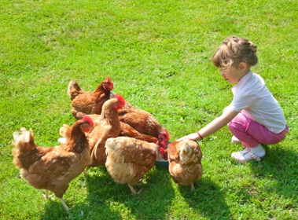
Opportunities & Challenges
“Better for You” products…
Free Range
Antibiotic
Free
Organic
Natural
Local
Sustainable
Non-GMO

Slide 14
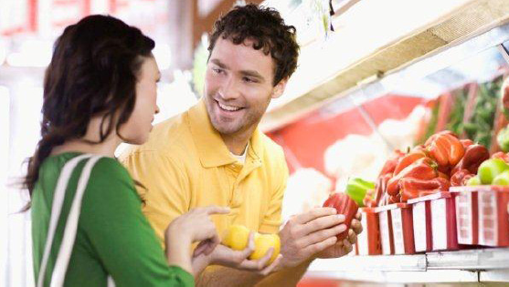
Why are they buying Natural/Organic?
More people than we think….
74% of US consumers purchase organic products
97% of US households buy natural products
36% of US consumers use organic foods at least monthly
Consumers with health concerns
Consumers with environmental concerns
Pregnant women
Parents with children
Consumers with weight problems
Source: (SPINS Year – End Overview, 2013)

Slide 15
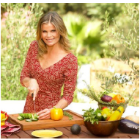

Why are they buying Natural/Organic?
40.4% I am concerned about chemical/antibiotic levels in conventional products
36.5% Organic foods are healthier for me
28.7% Organic products are higher quality and taste better
26.3% I care about the environment
9.1% For my children
Each group represents 9% of the U.S. population, but together account for 46% of all natural/organic product sales
True Believers
Enlightened Environmentalists
Source: Survey Monkey and Wells Fargo Securities, LLC

Slide 16
Barriers to entry
Why won’t people buy Natural/Organic?
Price
Merchandising
Trust
Label confusion
Not worth it
Availability
39% To Expensive
28% I don’t think it’s worth it to pay more vs. conventional products
8% Hard to find where I live
8% Another reason
Organic prices should start to decline as feed supply grows and key players increase their investments in lower prices
Source: Survey Monkey and Wells Fargo Securities, LLC

Slide 17
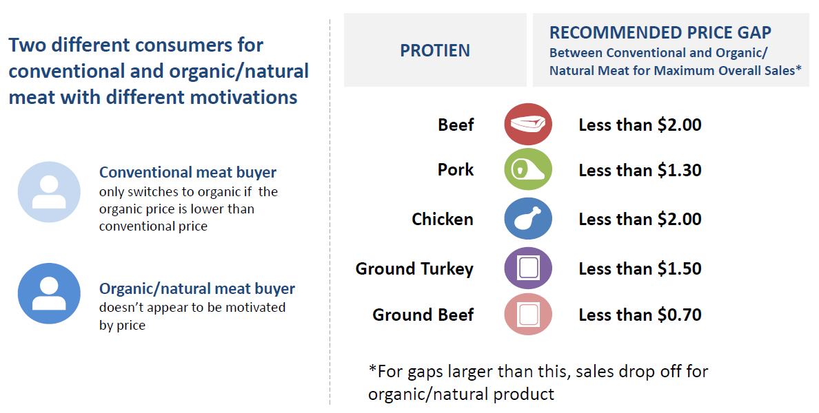
Barriers to entry
Conventional & Organic meat should differ by protein
Conventional consumer
Organic/natural consumer
Source: Nielsen Perishables Group FreshFacts® 52 weeks ending 9/27/14

Slide 18


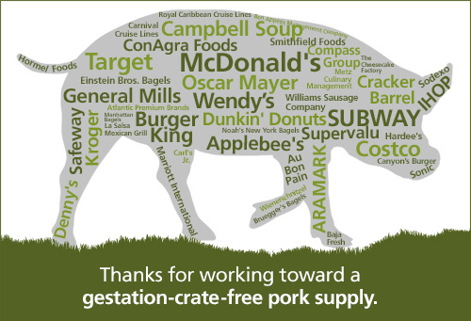











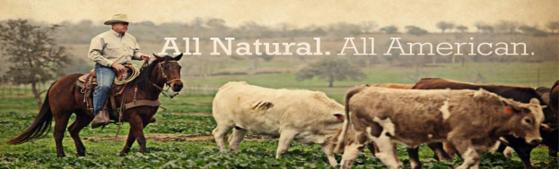

Product Claims
Product Claims

Slide 19
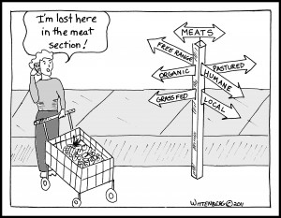
What does ‘Natural’ mean?
Survey of 2,500 consumers…
58% Organic
40% No Chemicals/ artificial substances added
39% Coming from Nature
37% No additives
29% Hormone-Free
20% No artificial flavors
18% Not Modified/Not Processed
17% No Colorings
13% Environmentally friendly
13% Healthy
13% From animals reared outdoors
13% No preservatives
11% No Fats
79% of people polled said they think food companies should provide more information to consumers about the way their products are grown and manufactured
Letterhead Food Research. Base 2,500 consumers

Slide 20
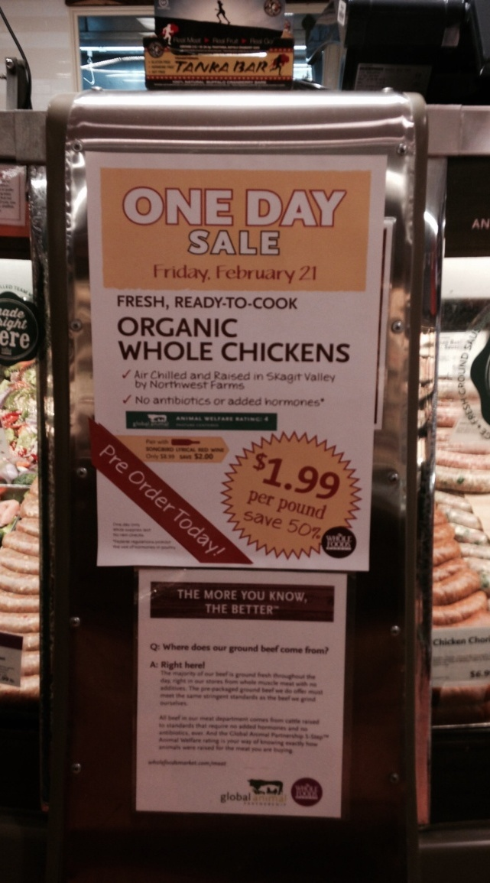
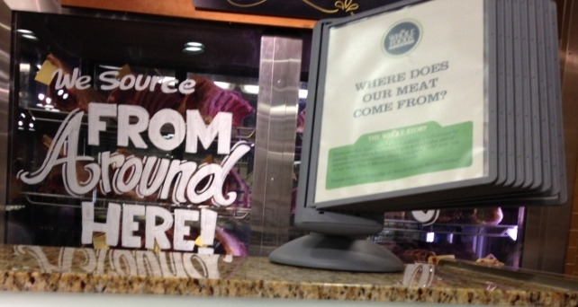
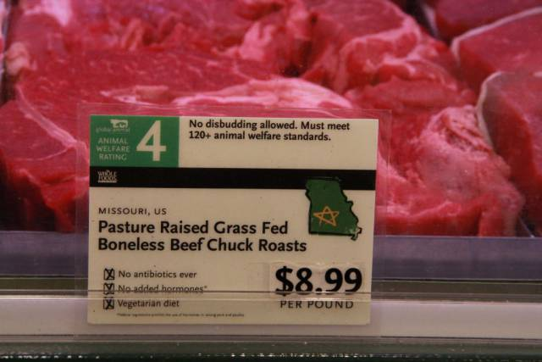
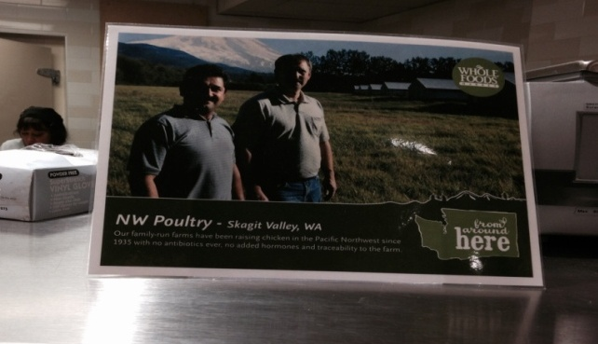
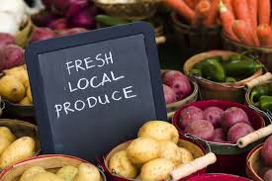
Locally Sourced
Using a state map and a star shows the location of the farm of locally grown products.
Promotions
Local Products
Telling the Story

Slide 21
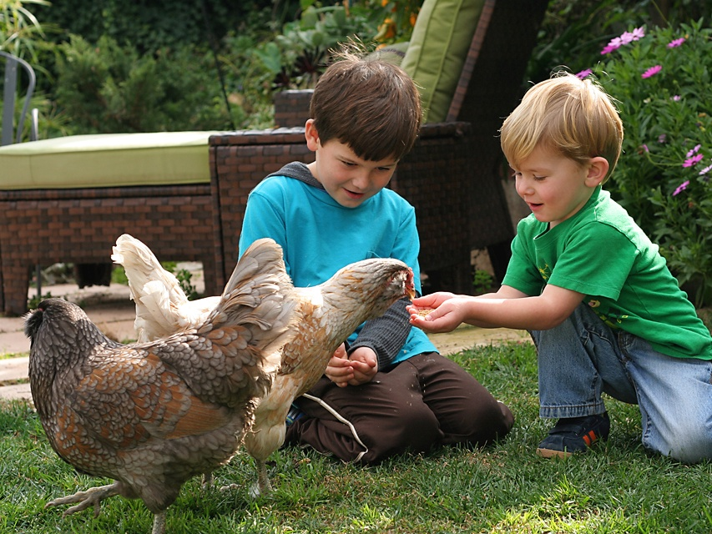
Challenges & Opportunities
Opportunities & Challenges
“Value Added” products…
Why Value added…
Fresh
Panko Breading
Marinated
Flavor Profiles
Rubs
Prepared in-store
Case Ready

Slide 22




The New Definition of Value
And tangible implications around monetary topics
  Smaller sizes, lower prices
  Cheaper cuts of meat
  Value Added
  Ready to cook packaging
Value Re-defined
Consumers look for value, but have redefined value to go beyond price. This includes time, money, etc.
Informed Shopping
Consumers are smarter than ever and with technology, are researching product and services before they even get to the store.
Notes:
Value re-defined—money but also value for the money…is it worth it?
Informed shopping – internet, mobile –shopper very informed

Slide 23

Value Added
Poultry Leads the way in value added
Most Popular by protein
54% of the retailers surveyed have a value added meat program
Consistencies in store prepared products.
Associate training
Flavor Profiles
Eye appeal (Freshness)
Packaging
36%
85% of the retailers having a value added program were Private Branded.
Chicken
35%
Pork
All of the retailers surveyed used roll stock for their value added packaging.
29%
Beef

Slide 24
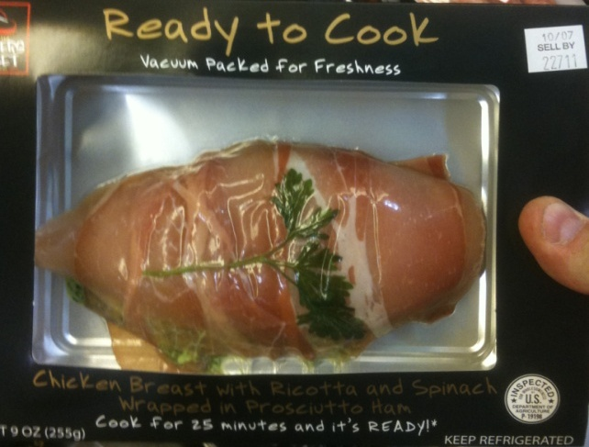
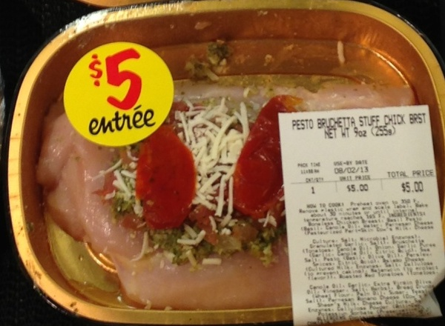
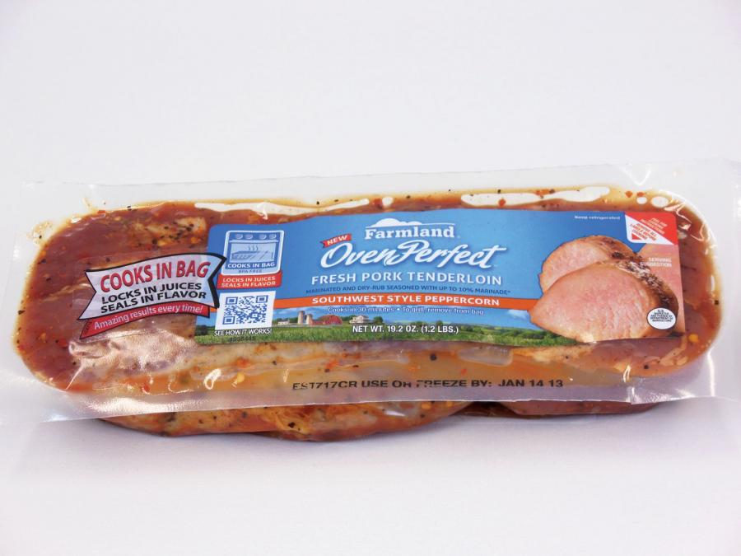
Value - Convenience
Packaging & Portion Control

Slide 25
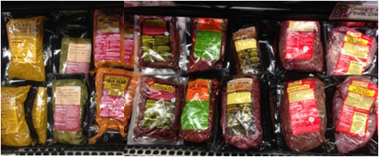
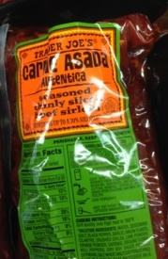
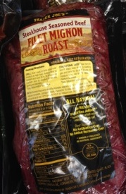
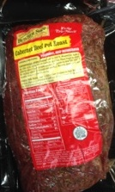
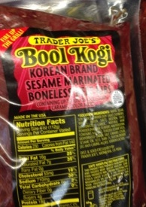
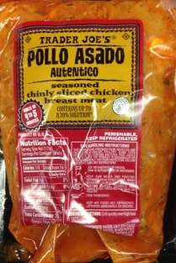
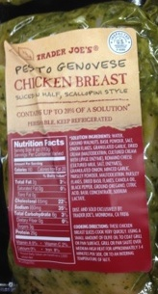
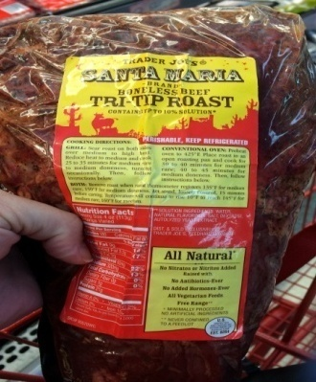


Value Added BIC Case Ready Retailer
Trader Joe’s marinated meat program has a wide variety of unique flavor profiles
Notes:
Book Kogi- Korean Brand Seasame marinated Boneless Beef Ribs. Est. #4858 Supplier/ Golden West Food Group
Curry Chicken Tenders Est. #4858 Supplier/ Golden West Food Group
Steakhouse Seasoned Beef Filet Mignon Roast Est. #8264 Supplier/ Richwood Meat Co, Inc.
Hawaiian Style Boneless Beef Short Ribs Est. # 2880 Supplier/ Specialty Branded Products
Herb & Garlic Seasoned Sirloin Steak chim churri sauce Est. #4858 Supplier/ Golden West Food Group
Pesto Genovese Chicken Breast sliced in half scallopini style Est. #4858 Supplier/ Golden West Food Group
Pollo Asado Autentico Seasoned thinly sliced chicken breast meat. Est. #4858 Supplier/ Golden West Food Group
Carne Asado Autentico thinly sliced beef sirloin for carne asado seasoned with autentico recipe. Est.# 4858 Supplier/ Golden West Food Group
Santa Maria Boneless Beef Tri-Tip Roast. Est. #8264 Supplier/ Richwood Meat Co, Inc.

Slide 26



Value Added Retailer BIC Service Counter
Whole Foods is known for their Organic & Natural foods but they also pay attention to the details. Look at the color combinations and the workmanship from one section to the next.
Panko Breadings
Marinades & Rubs
Stuffing's

Slide 27
THANK YOU!

Slide 28
Contact Information
Brian Diffenderfer
Daymon Worldwide
bdiffenderfer@daymon.com
(443)240-9556

