Slide 1
Global Outlook for U.S. Chicken
NCC / US Poultry Chicken Media Summit | Friday, April 19, 2013

Slide 2
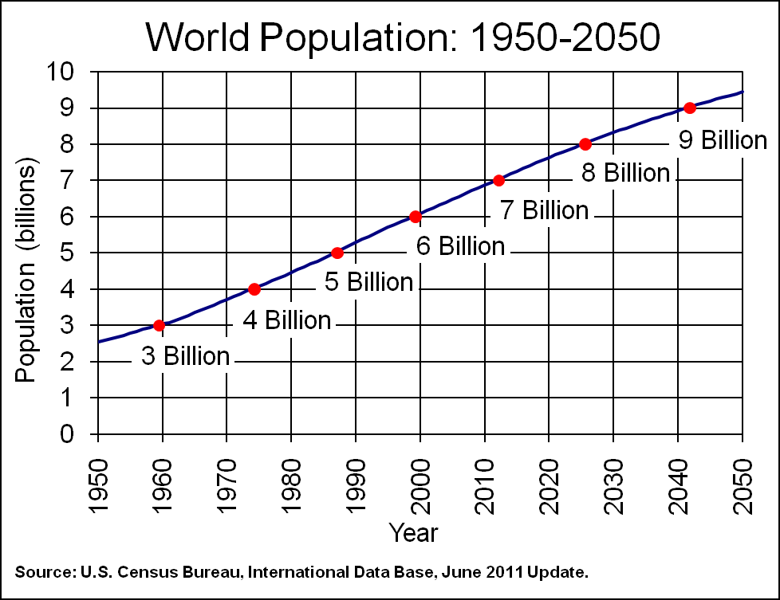
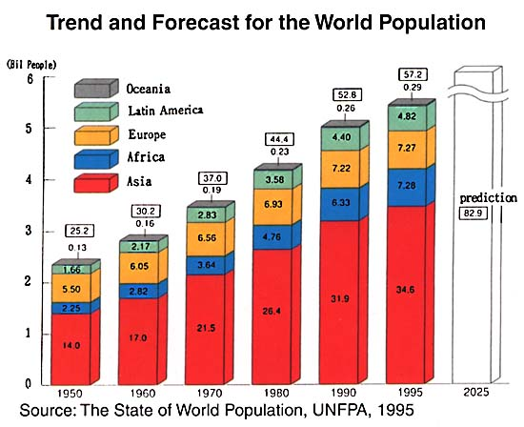
WORLD POPULATION PROJECTION
Global population is expected to surpass 7.5 billion by 2020 led by developing countries in Africa and Asia.

Slide 3
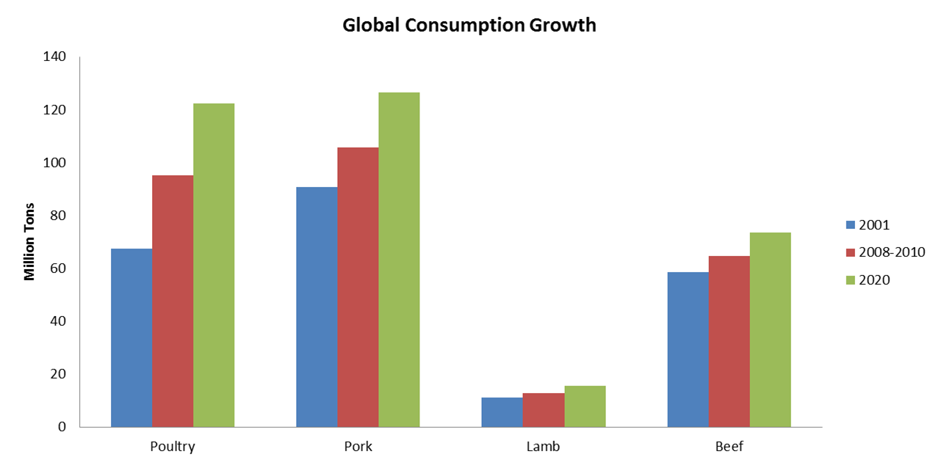
MEAT CONSUMPTION FORECAST
Chicken is forecasted to lead global growth in protein consumption into 2020.
Source: FAO

Slide 4
GLOBAL PROTEIN DEMAND GROWTH
North America
North Asia
+47.7%
E.U. – 27
+3.0%
+7.5%
Middle East
+41.4%
+23.7%
East Asia
Central America
+29%
+70.2%
Southeast Asia
+48.7%
+32.2%
South America
Oceania
+23.3%
Africa

Slide 5
GLOBAL PROTEIN SUPPLY
Surplus
Deficit
Beef & Veal
Pork
Chicken
Source: Rabobank

Slide 6
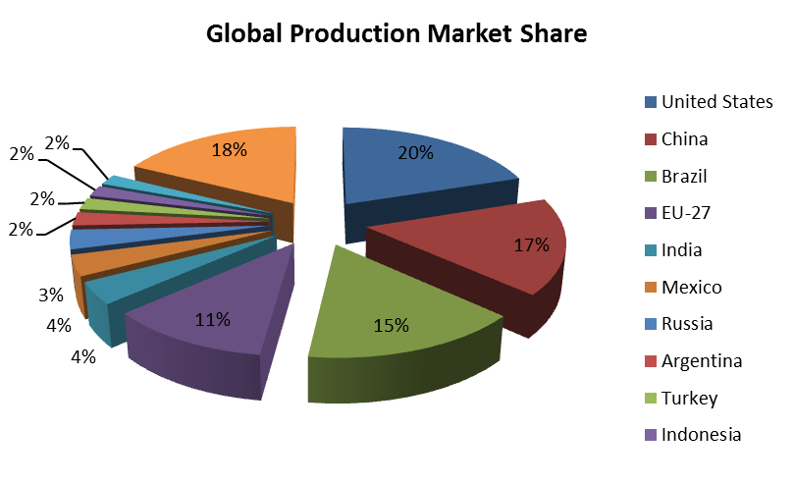
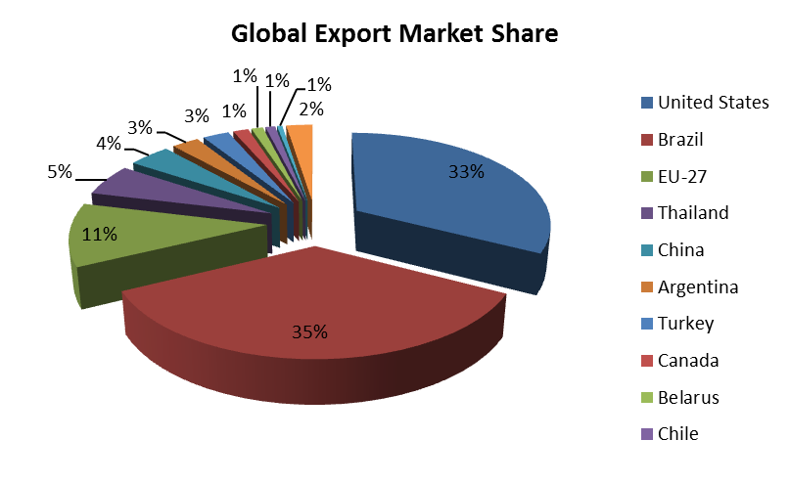
UNITED STATES vs. BRAZIL
The U.S. and Brazil account for 35% of global production and 68% of global exports.
Source: USDA

Slide 7
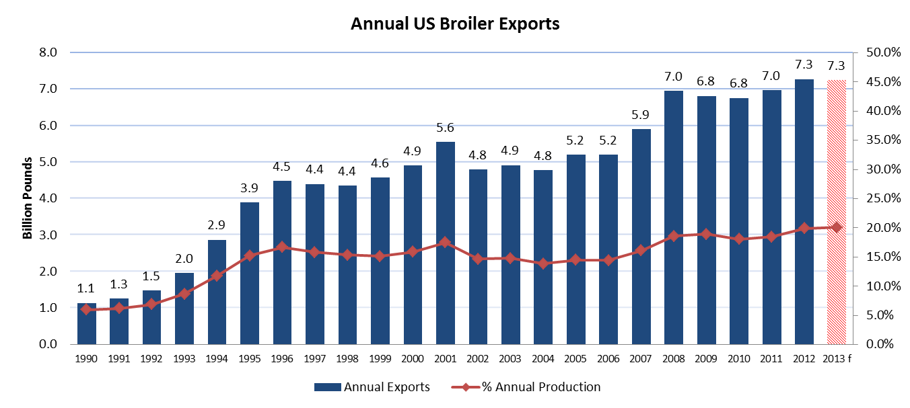
U.S. EXPORTS
2012 export volumes set a new record at 7.3 billion pounds, a 4.5% increase from last year’s record.
USDA forecasts another strong year of exports in 2013. January exports were up 3% from last year.
Source: USDA, FAS

Slide 8
WHY U.S. GROWN & PRODUCED CHICKEN?
Value & Affordability
Wholesome, Nutritious & Safe
Distribution & Logistics

