Slide 1

National Chicken Council
2011 Marketing Survey Results

Slide 3
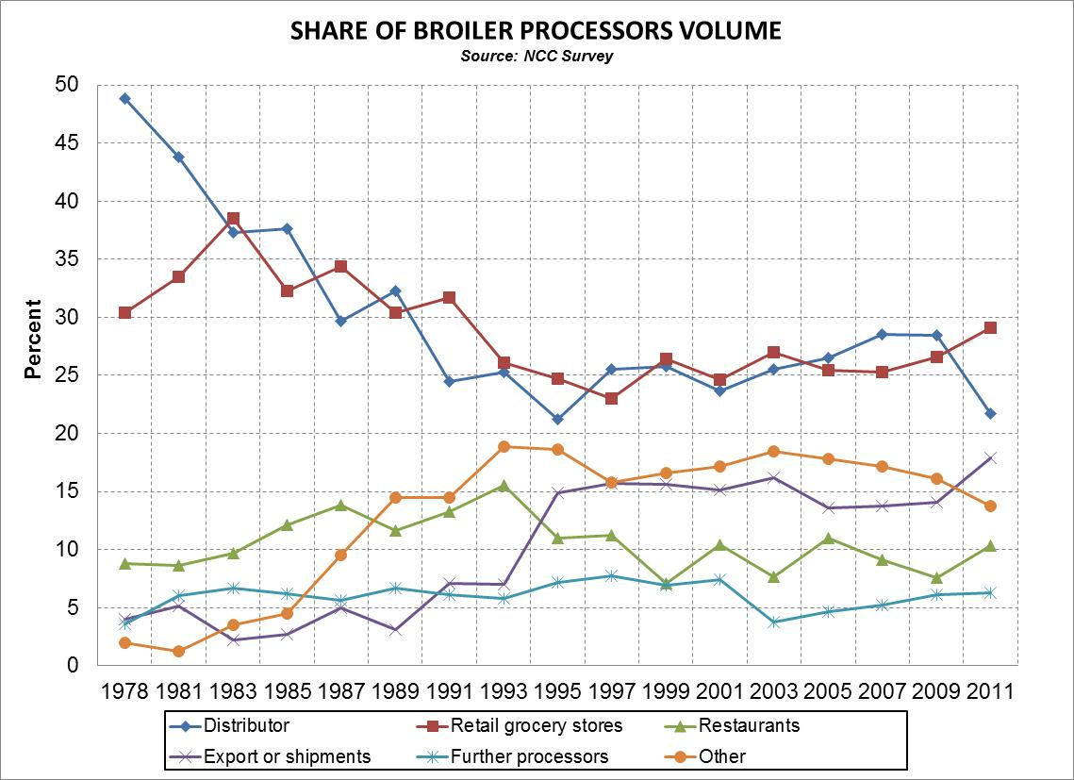

Slide 5
Processor Marketings: Product Forms and Market Channels
(Table A-4a) NCC Survey

Slide 6
Processor Marketings: Product Forms and Market Channels
(Table A-4a) NCC Survey

Slide 7
Processor Marketings: Product Forms and Market Channels
(Table A-4a) NCC Survey

Slide 8
Processor Marketings: Product Forms and Market Channels
(Table A-4a) NCC Survey

